Slide 1
MY PROJECT MGMT APP
MOB WEB DEV PROJECT

Slide 2
MY PROJECT MANAGEMENT APP
Objective :
To create a Simple Project Management App with Authentication and
Cloud Function.
Dependencies :
React, Redux & Thunk Package
Firebase
Firestore, authentication,cloud functions &hosting

Slide 3
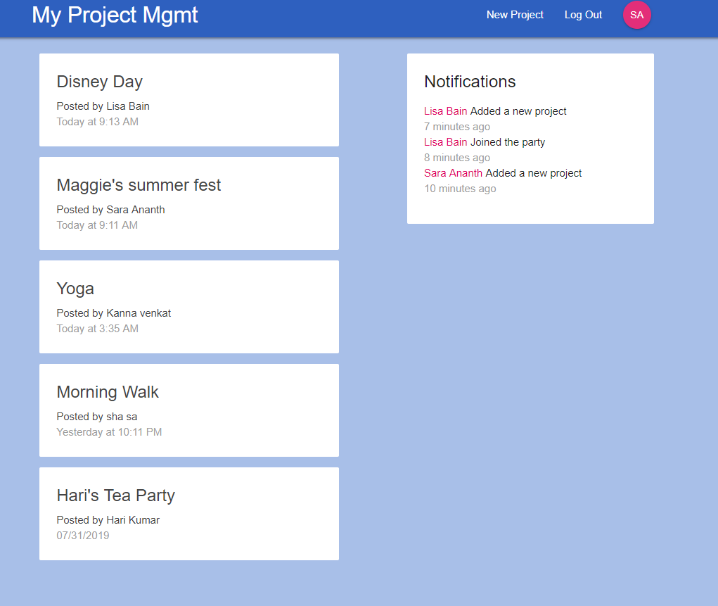
HOME PAGE

Slide 4
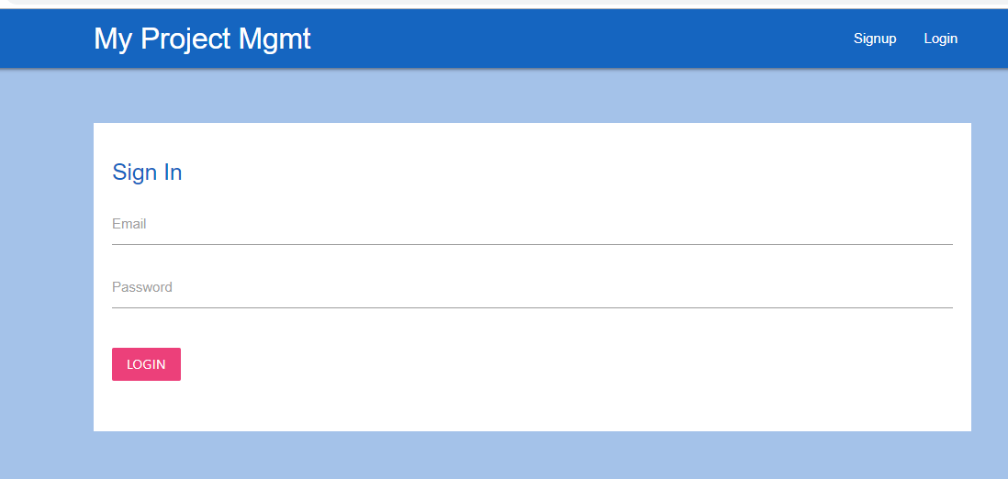
SIGN IN

Slide 5
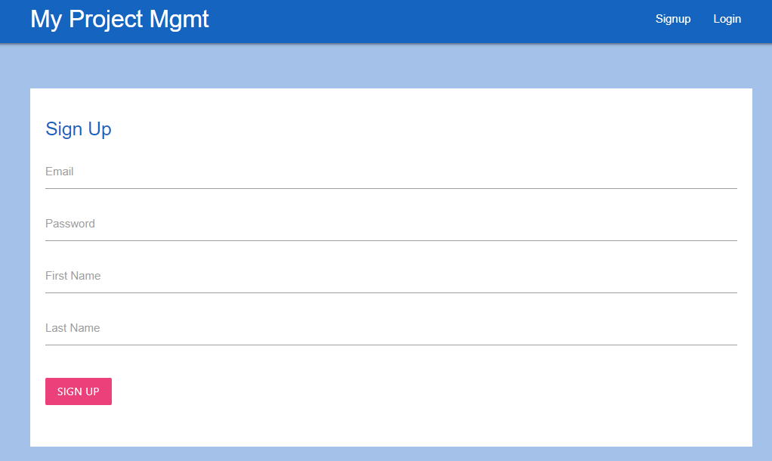
SIGN UP

Slide 6
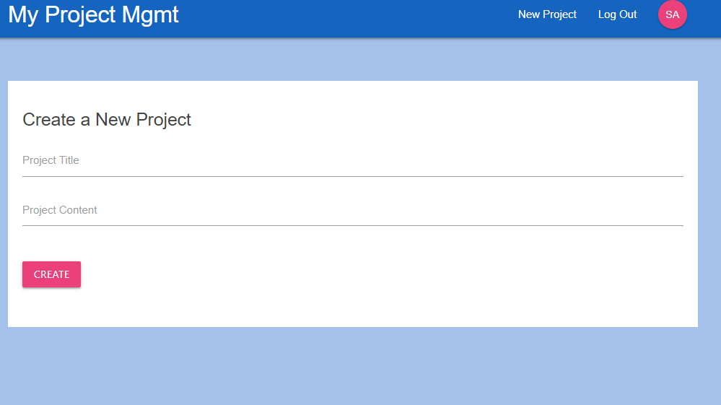
CREATE A NEW PROJECT

Slide 7
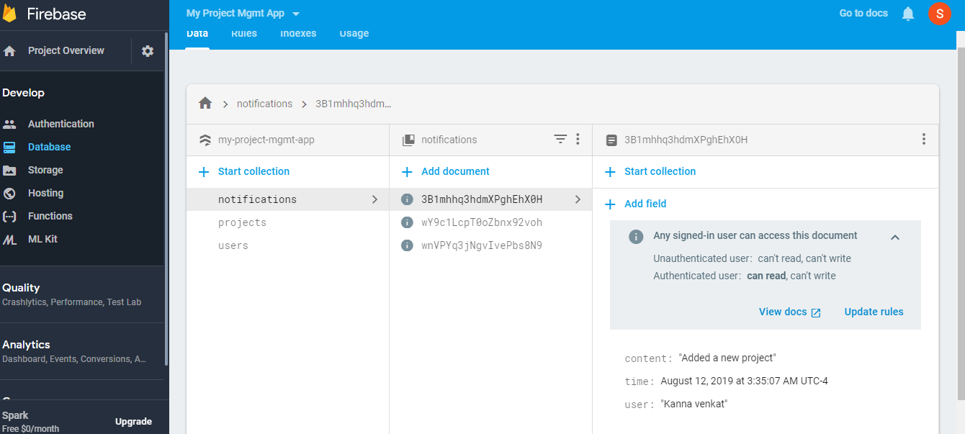
FIREBASE- NOTIFICATIONS

Slide 8
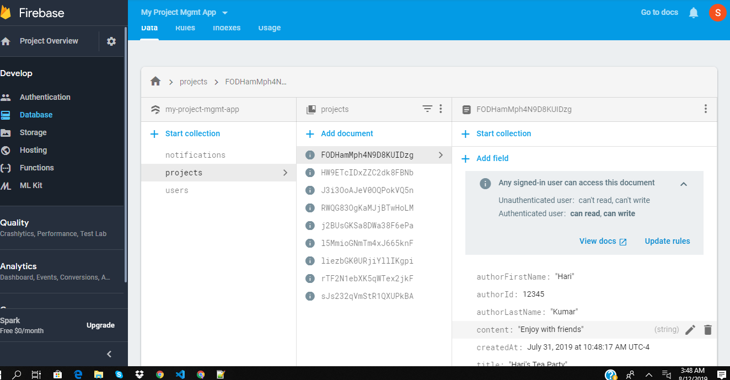
FIREBASE - PROJECTS

Slide 9
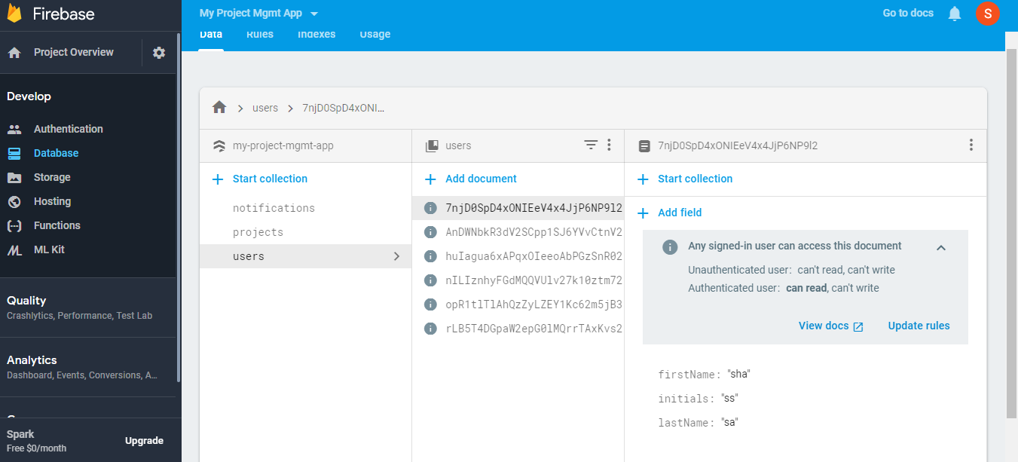
FIREBASE - USERS

